Slide 1
RISCV Final
吳建翰、周光照、鄭謹譯
2020.06.29

Slide 2
Outline
1
Baseline : Special Design
2
Extension : Comparisons
3
Assignment

Slide 3
Baseline
Pipeline
Structure
Forwarding
Unit
Hazard
Unit
L1
Cache

Slide 4
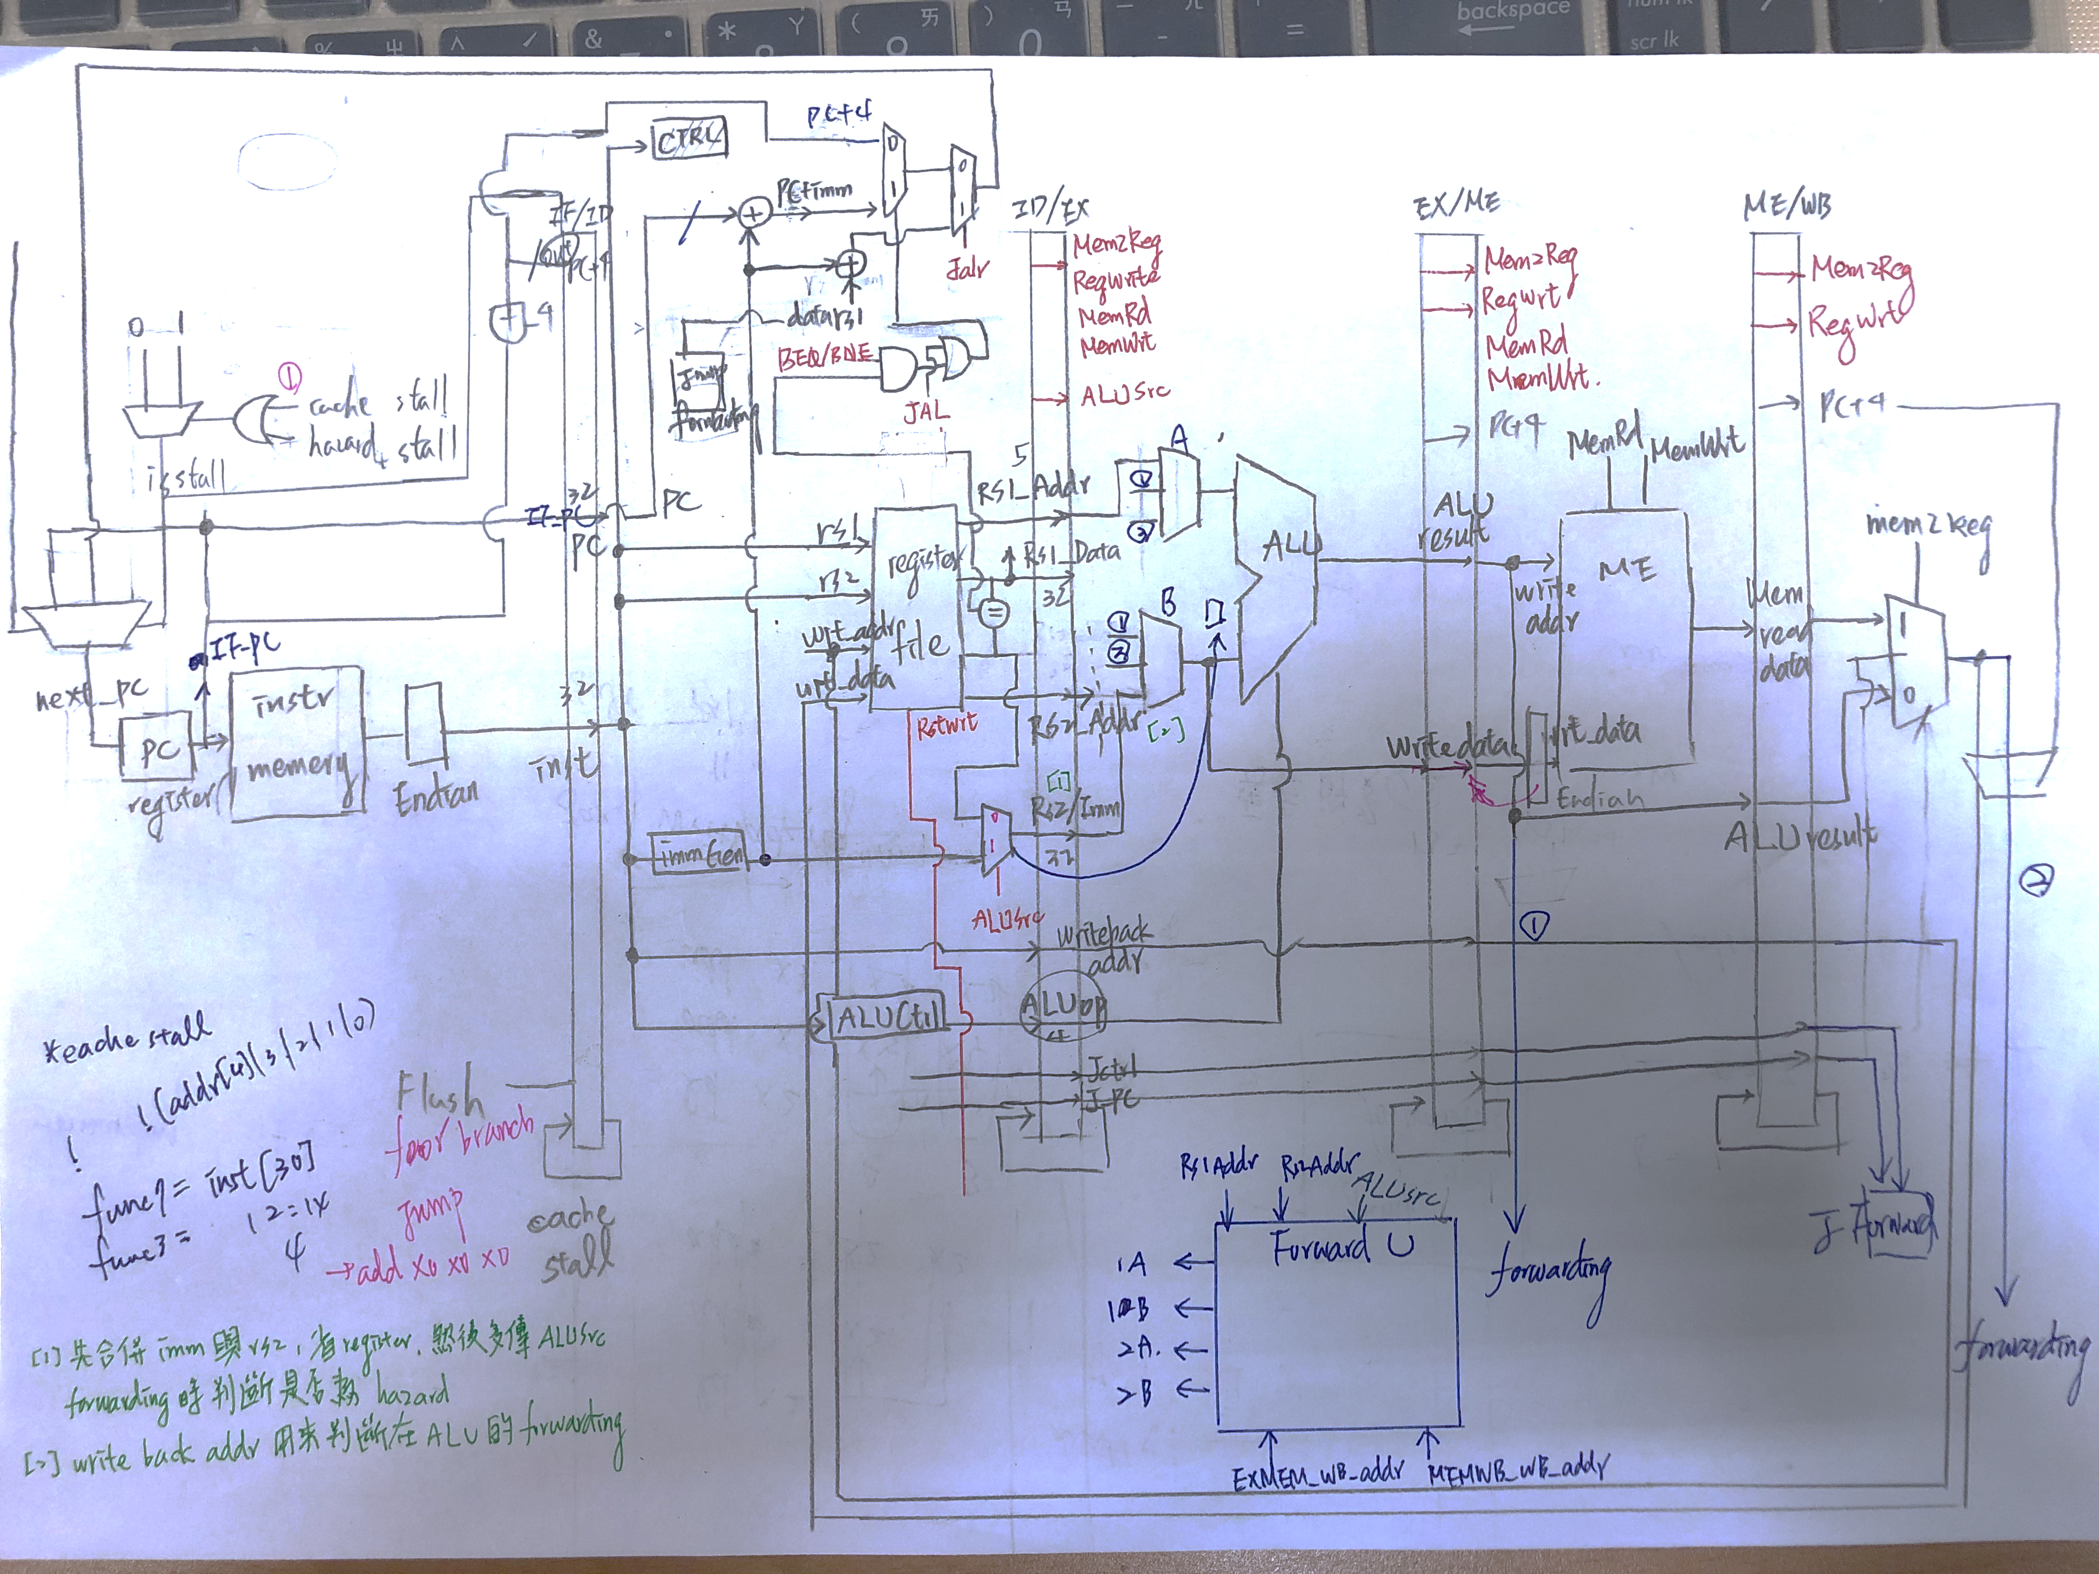
Baseline Structure V2

Slide 5
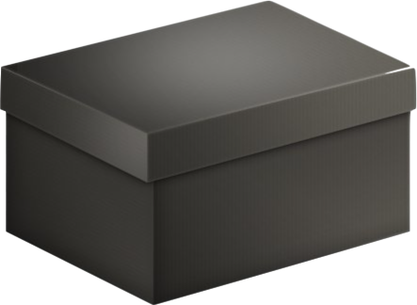
Baseline Enhancement
Redraw
KMAP
Shorten
Critical Path

Slide 6
Extension
L2 Cache
DM
2ways
Non-uniform
BPU
Always-not-taken
Always-taken
1-bit
2-bit
Reverse 1-bit
2-bit v2.0
Compression
PC +2 or +4
PC always +4

Slide 7
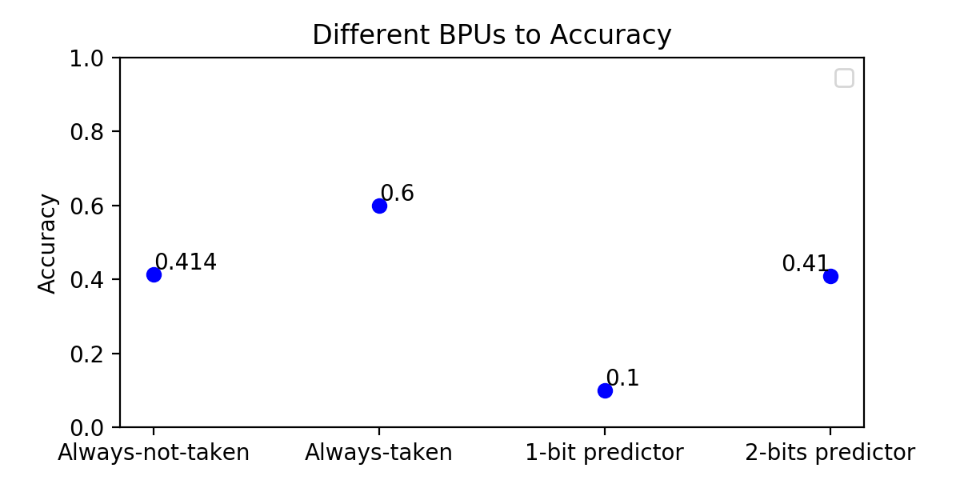
Branch Prediction Unit
Most branch patterns are interleaving patterns in hasHazard.
Poor accuracy of 1-bit or 2-bit.

Slide 8
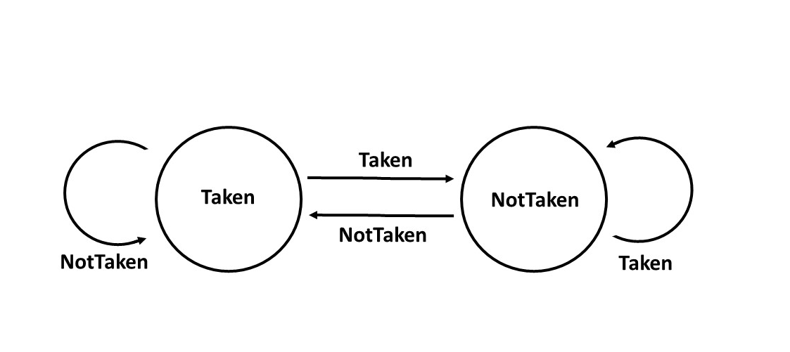
Another idea of BPU

Slide 9
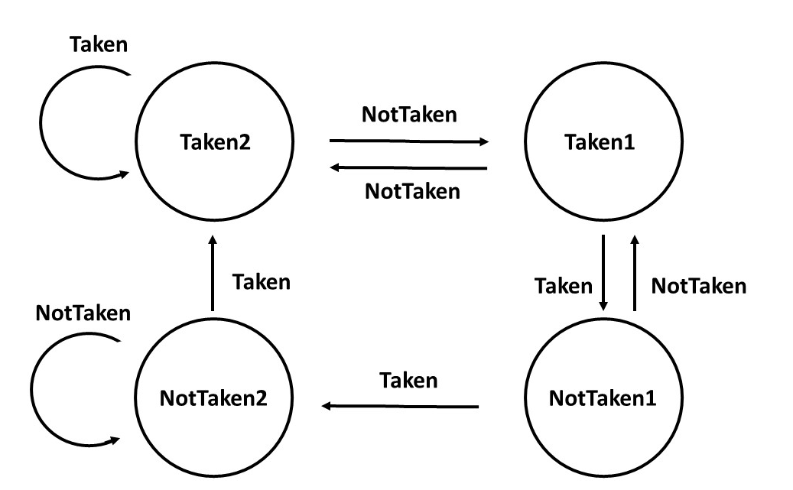
Another idea of BPU
For interleaving patterns
For always-taken patterns
after interleaving patterns

Slide 10
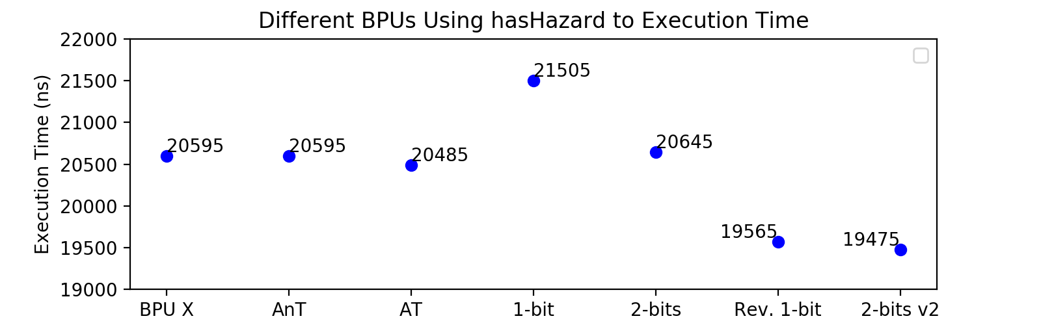
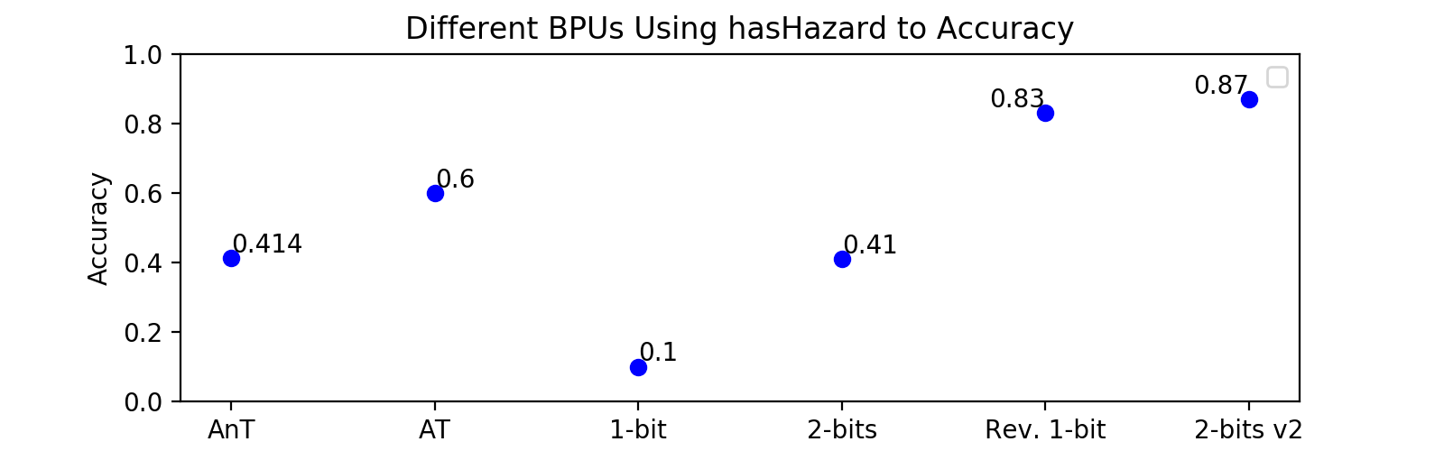
Analysis-hasHazard

Slide 11
Analysis-BrPred
When the number of a (never) ↑, the number of c (always) ↓
2-bit v2.0 has bad performance because there are more never-branch patterns.
When the number of b (interleave) ↑
1-bit predictor and 2-bit predictor will perform poorly.
Reverse 1-bit and 2-bit v2.0 can maintain comparatively good performance.

Slide 12
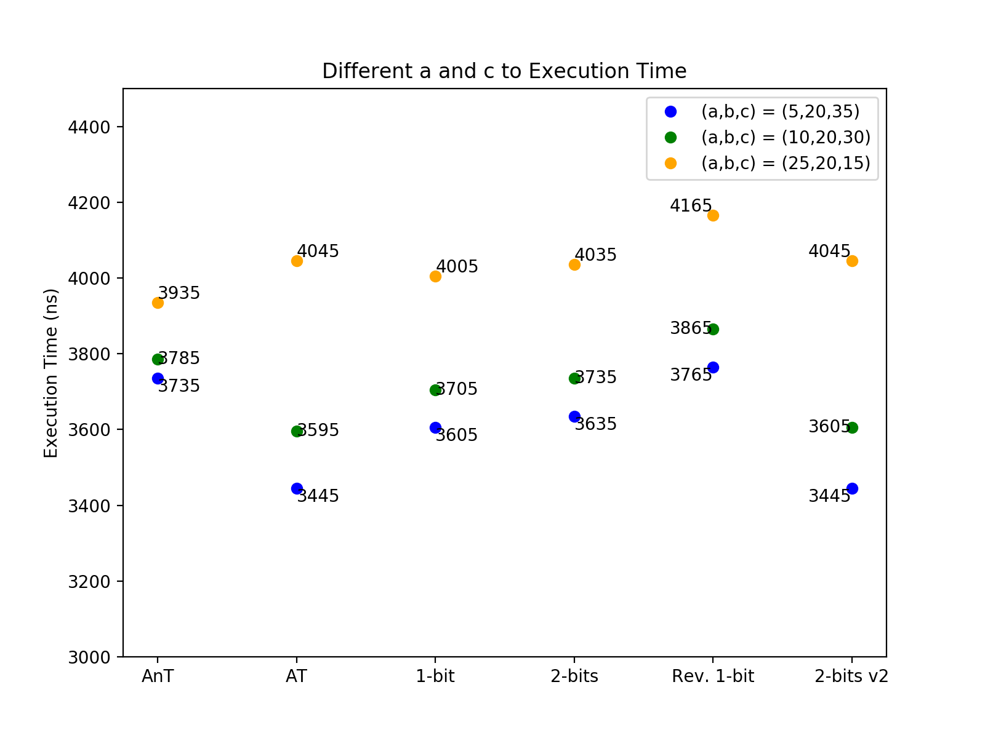
a vs c

Slide 13
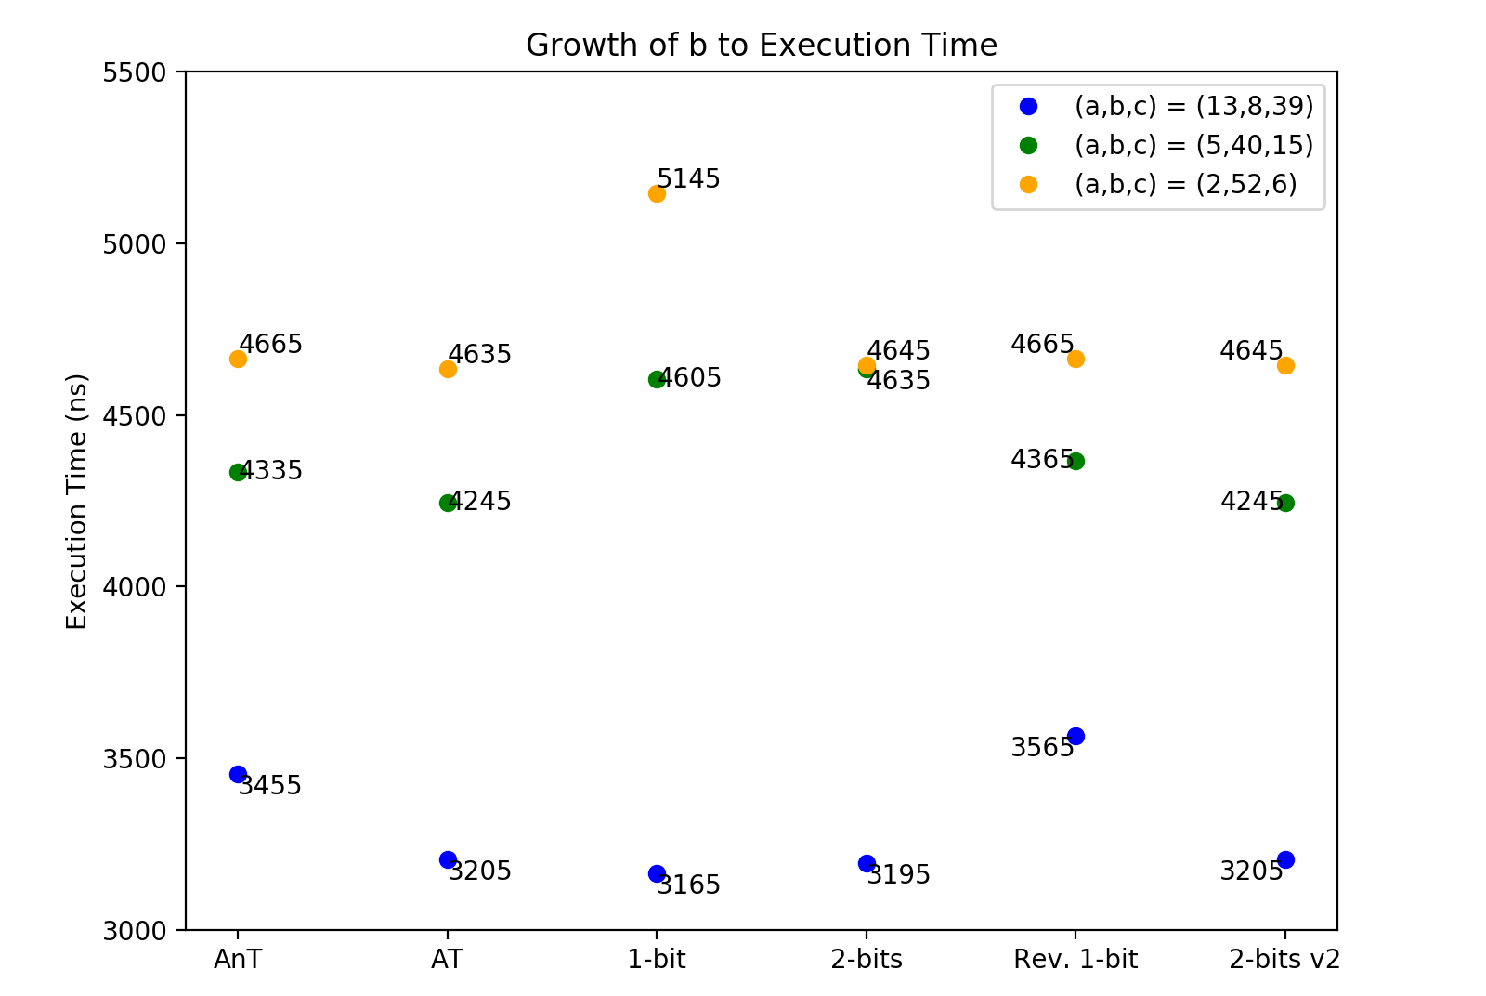
Growth of b

Slide 14
Compression FSM
Flush |
32
Stall
| Stall
RIGHT
BUF RIGHT
16
32
&~Flush
&~Flush
&~Stall
&~Stall
Always
&~Stall
~Stall&( )
16
Flush |
LEFT
Buffer
Stall

Slide 15

PC+2 or 4 vs PC+4 always
PC + 2or4
PC + 4 always
216509 um²
Area
212529 um²
3 ns
Cycle
3 ns
1573.5 ns
Time
1642.5 ns
3.407E+8
AT
3.491E+8

Slide 16
PC+2 or 4 vs PC+4 always
1573.5 ns
Time
1642.5 ns
PC always +4 encounters Jump or Branch
Flush

Slide 17
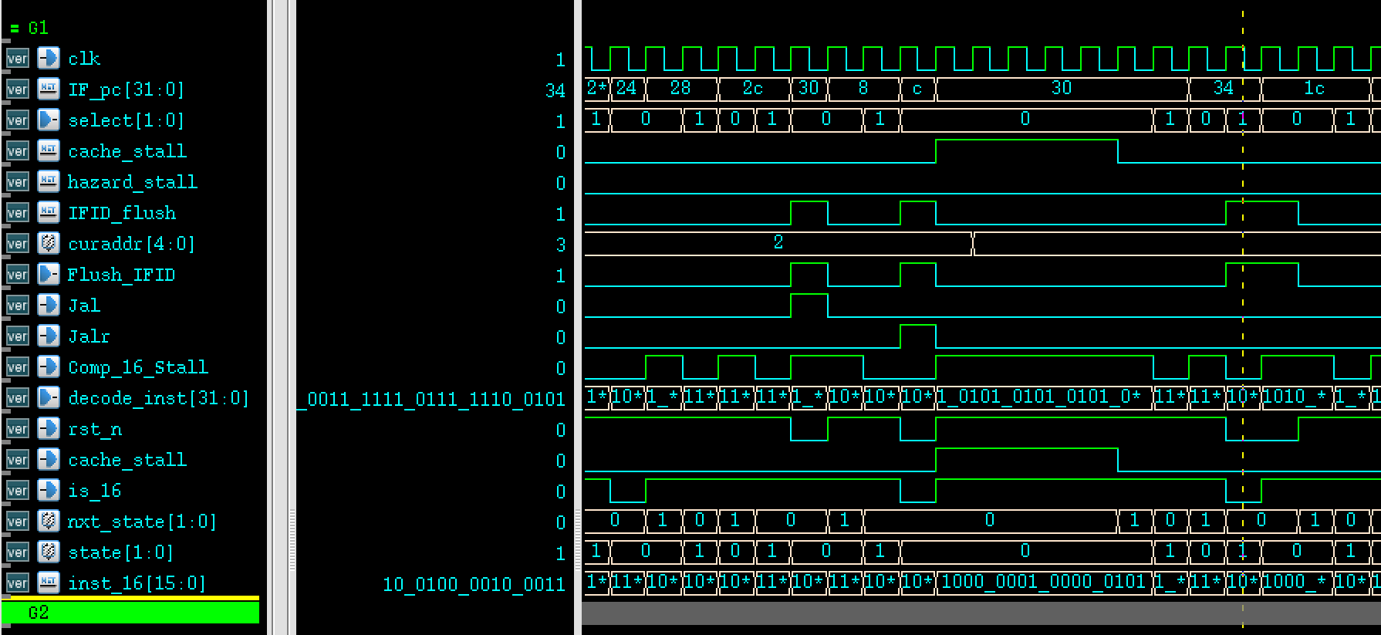
PC+4 always
1573.5 ns
Time
1642.5 ns

Slide 18
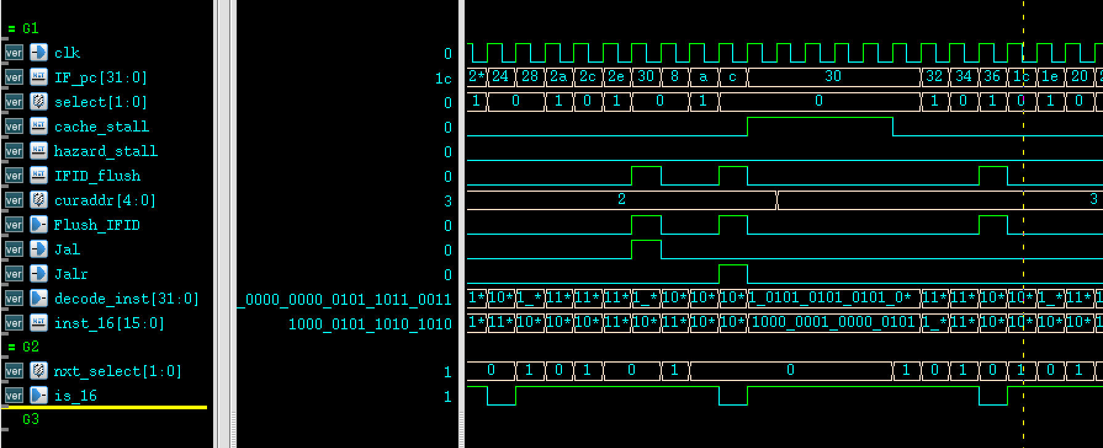
PC+2 or 4
1573.5 ns
Time
1642.5 ns

Slide 19
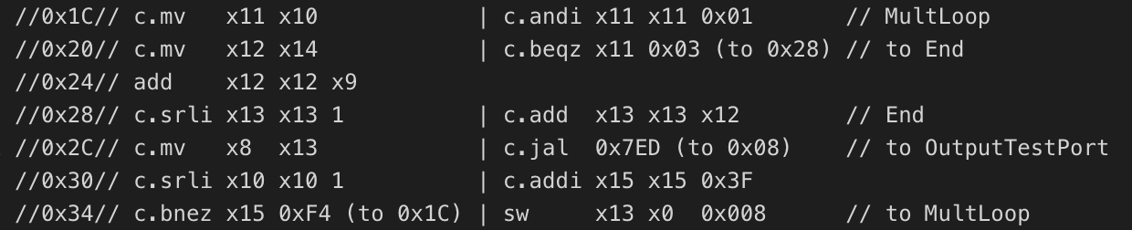
PC+2 or 4
1573.5 ns
Time
1642.5 ns

Slide 20
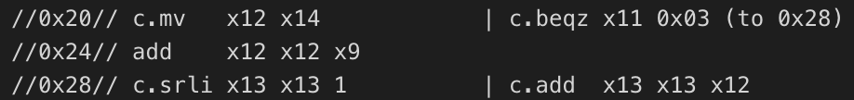
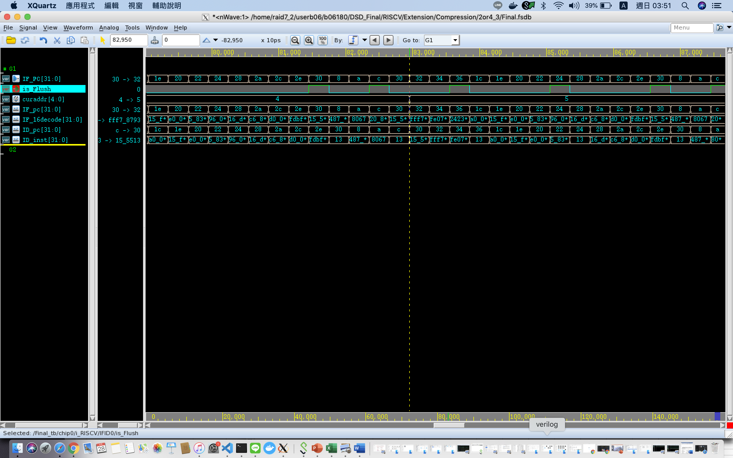
Some Facts
x1 or x0

Slide 21
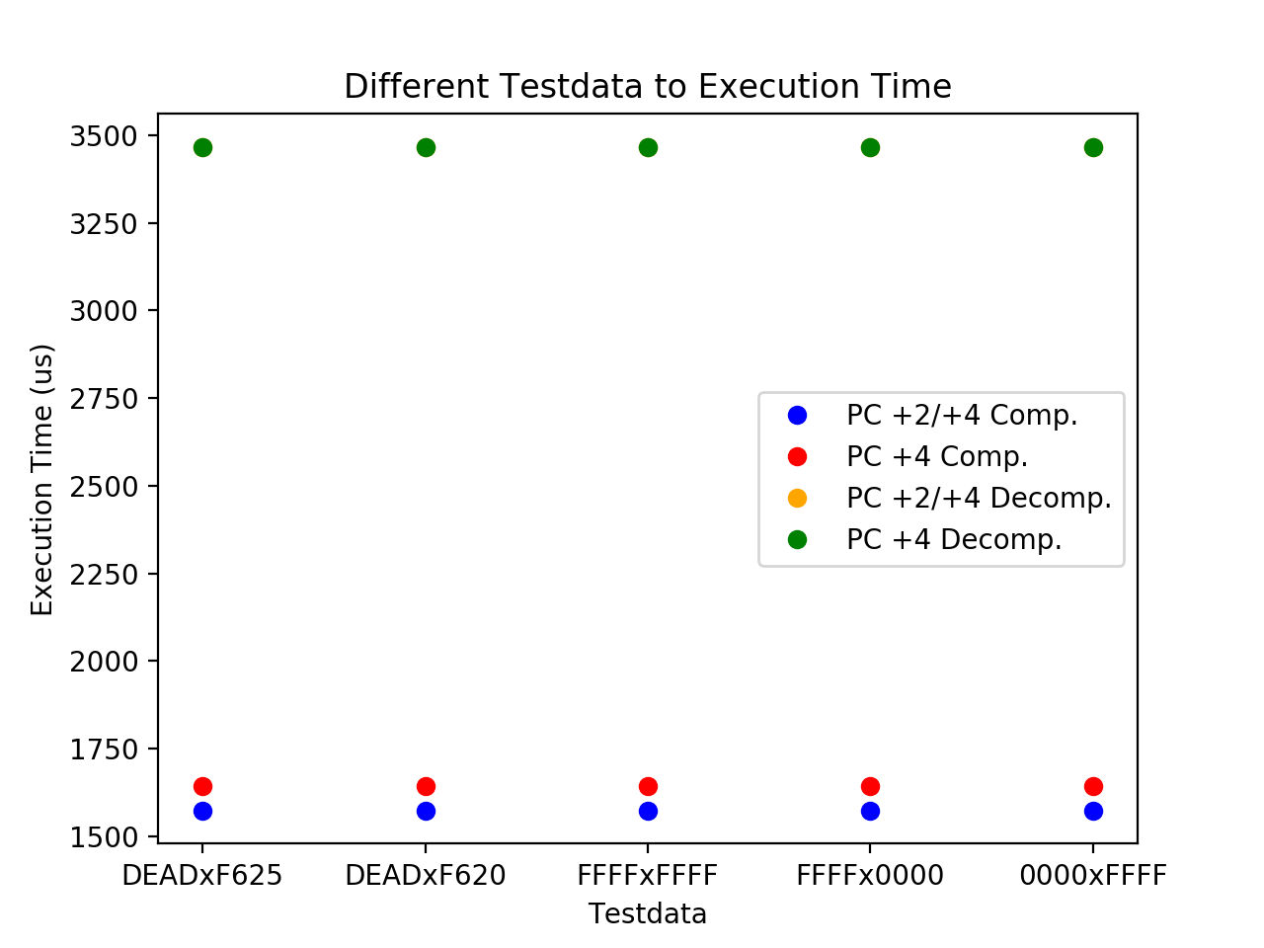
Comparisons

Slide 22
Assignment

Slide 23
Assignments
吳建翰
L2 Cache
鄭謹譯
Compression
周光照
Branch Prediction

Slide 24
Thank You!
吳建翰、周光照、鄭謹譯
2020.06.11

